Slide 1

Exploratory data analysis via linear regression
Presented by: John Manuel

Slide 2


INTRODUCTION
The dataset provided is based on flight data from JFK Airport covering the period from November 2019 to December 2020. (COVID-19 restricted flights, so data is only up to January)
Data contains 28,820 samples
23 Categorical Features

Slide 3
DATASET INDEX
MONTH – The month of the flight departure.
DAY_OF_MONTH – The day of the flight departure.
OP_UNIQUE_CARRIER – Airline carrier code identifying the operating airline.
DEP_DELAY – Flight delay (minutes) compared to the scheduled departure time.
Temperature – Temperature at departure time (degrees Fahrenheit).
Humidity – Humidity percentage recorded at departure time.
Wind Speed – Wind Speed at departure time (mph or knots).
Pressure – Atmospheric pressure at departure time.
TAXI_OUT – Taxi-out time (minutes) representing the time it takes for the aircraft to taxi from gate to the runway.

Slide 4
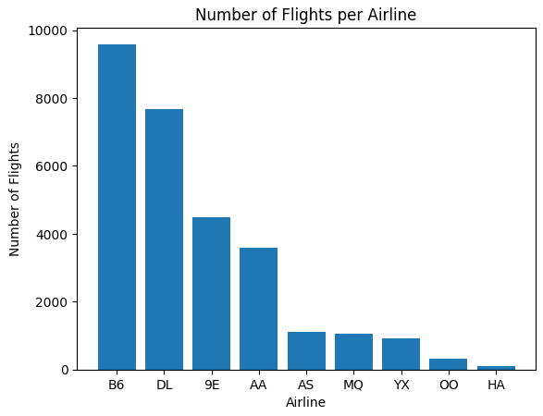
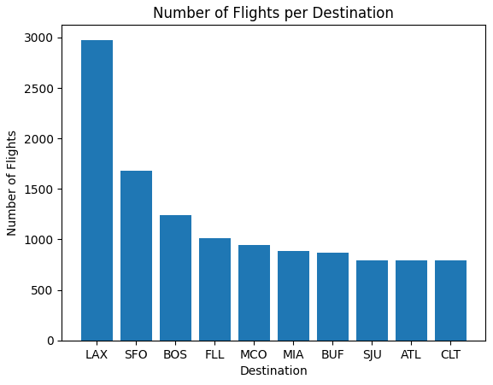
What does the data show? Number of flights per airline and Destination
Notes:
In the figure on the left, B6 or Jetblue Airways offered the highest number of flights recorded in this time period, while LAX or Los Angeles Airport received the most number of flights.
It would be interesting to explore the relationship between the flights and the percentage of these flights received by LAX or other destinations.

Slide 5
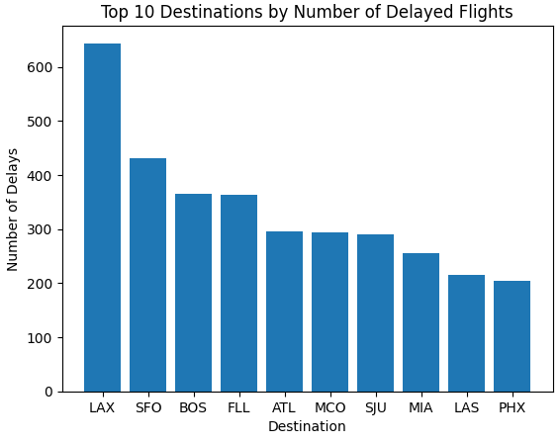
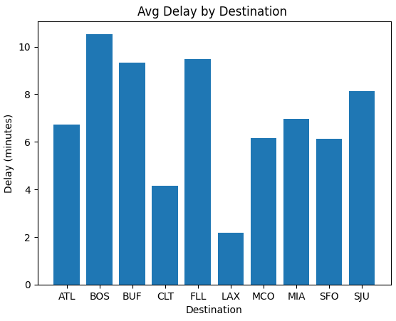
What does the data show? (How many minutes is the delay on average on various destinations?)
Notes:
The figures show that flights to LAX or Los Angeles Airport have the highest number of delays, although they have the shortest delay time (2 mins) from the examples.
The data also shows that flights to Boston Airport have the highest average delay, amounting to over 10 mins of average delay time.

Slide 6
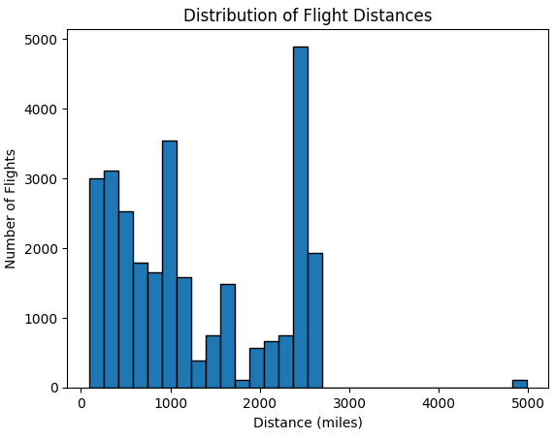
What does the data show? (Short or long-distance flights?)
Notes:
As we can see, most flights are of the 2500-mile flight distance. However, majority of flights are shorter distance sub 1000 miles.

Slide 7
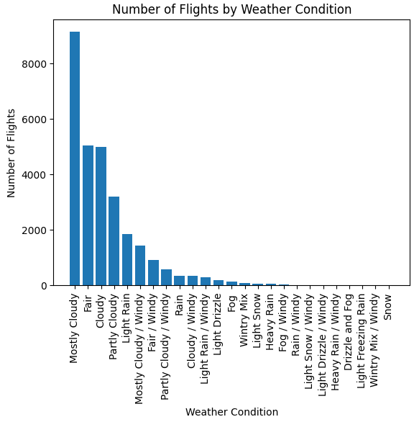
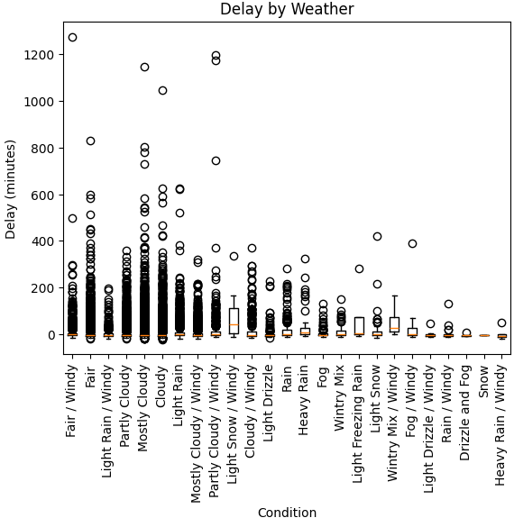
What does the data show? (How does the weather affect flights?)
Notes:
The figure on the left shows that most of the flights occurred on a ‘Mostly Cloudy’ day, which may mean that flights are not permitted in snowy conditions.
The figure on the right shows that delay and weather conditions have no strong direct correlation, as adverse weather conditions might mean no flights, thus less/no data are collected in that period.

Slide 8
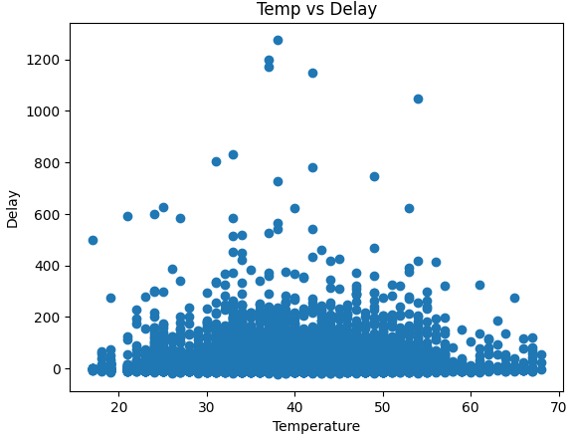
What does the data show? (Relationship between temperature and delays)
Notes:
This data shows temperatures on the day the delays occurred. As seen, there is no direct correlation between the two.

Slide 9
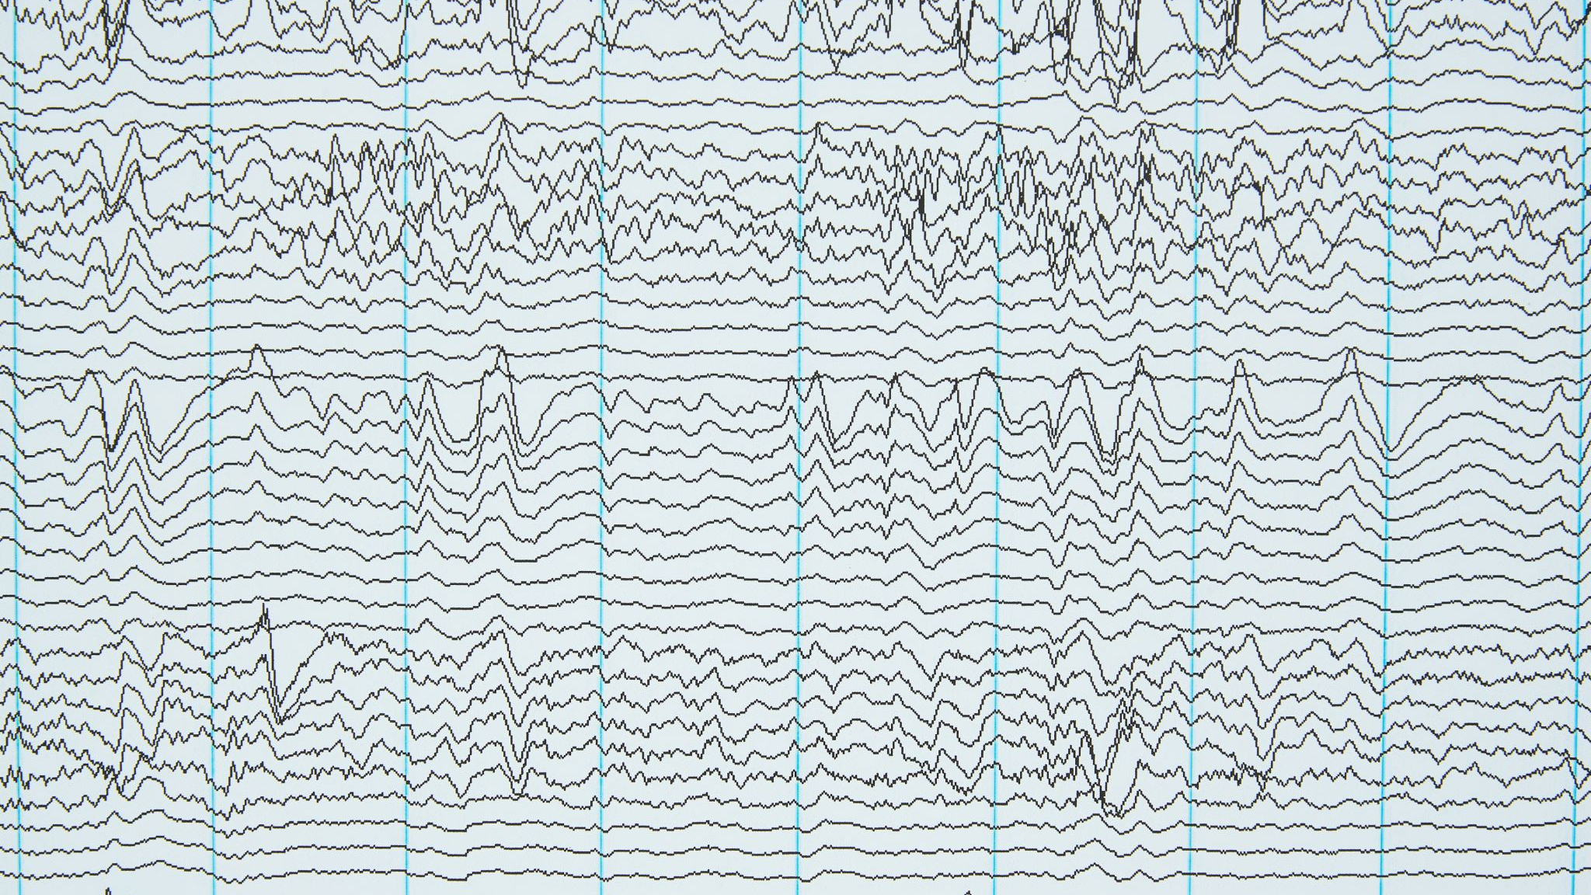
Linear regression

Slide 10
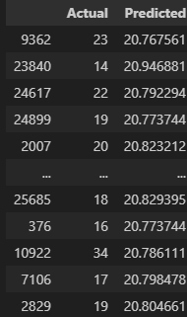
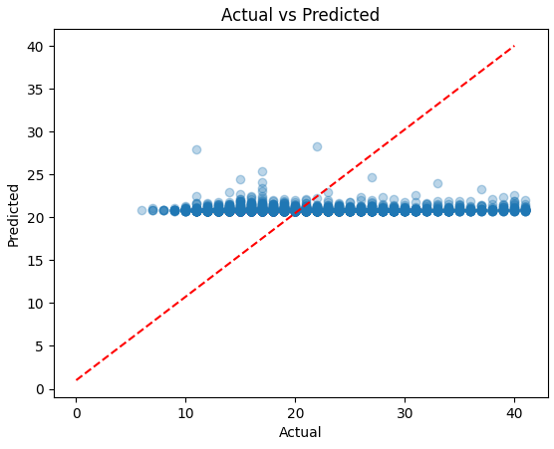
Simple linear regression
MSE: 47.86709056697605
R2: 0.0013034144832426708
Notes:
Using only DEP_DELAY and TAXI_OUT, a simple linear regression model is created, which clearly shows no correlation on the linearity line, and one whose predictions gave an R2 of 0.001, meaning close to zero correlation.
This model showed the worst prediction out of the models utilised.

Slide 11
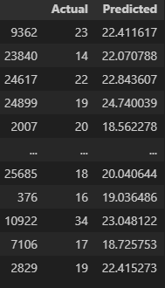

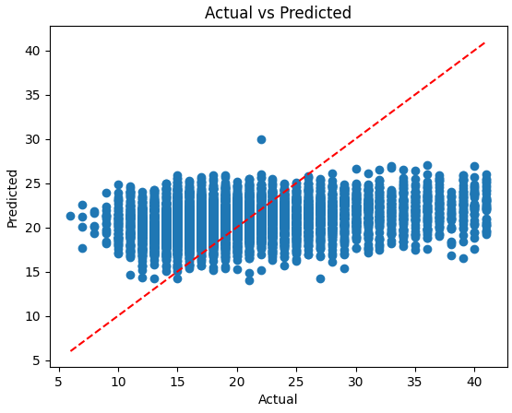
Multiple linear regression
MSE: 43.87153709099075
R2: 0.08466644253552846
Notes:
Utilising all other categories compared to TAXI_OUT, the model prediction still showed no direct correlation on the actual values. It did however, showed gave an r2 of 0.08 meaning an 8% correlation. Model still unreliable for predicting TAXI_OUT.

Slide 12
RIDGE (l2 REGULARIZATION)
MSE: 43.87153709099075
R2: 0.08466644253552846
Notes:
The Ridge (L2 regularisation) model is also used. It also gave an 8% correlation, but this is still unreliable.

Slide 13
Lasso (l1 regularization)
MSE: 44.26863125300976
R2: 0.07638148978323767
Notes:
The Ridge (L2 regularisation) model is also used. It also gave a slightly lower, 7.6% correlation, which is still unreliable.

Slide 14

Conclusions
In conclusion, all three models used—linear, Ridge, and Lasso—showed limited predictive performance with R2 values below 0.1, meaning they showed less than 10% variability between predicted outcomes.
Various reasons can be taken into account, such as the suitability of these models for the dataset presented; however, some steps could be taken to improve data performance:
Categories like Month and Airline Carrier Codes could have been dropped, as they don’t affect the prediction; some categories like weather, airline, and destination were not handled correctly, as they are text values, and regression models need numerical data to function fully. These could have been converted from text into numbers.
More reliable methods should be utilised for predicting TAXI_OUT.

